Slide 1
Non-revisiting Coverage Task with Minimal Discontinuities for Non-redundant Manipulators
Tong Yang, Jaime Valls Miro, Yue Wang, Rong Xiong
Robotic Laboratory, Zhejiang University
Centre for Autonomous Systems (CAS), University of Technology Sydney

Slide 2
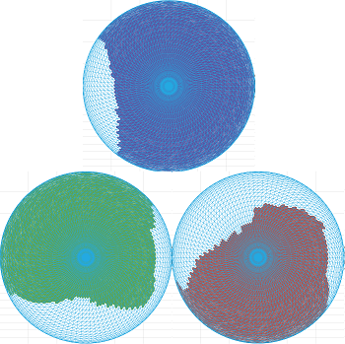
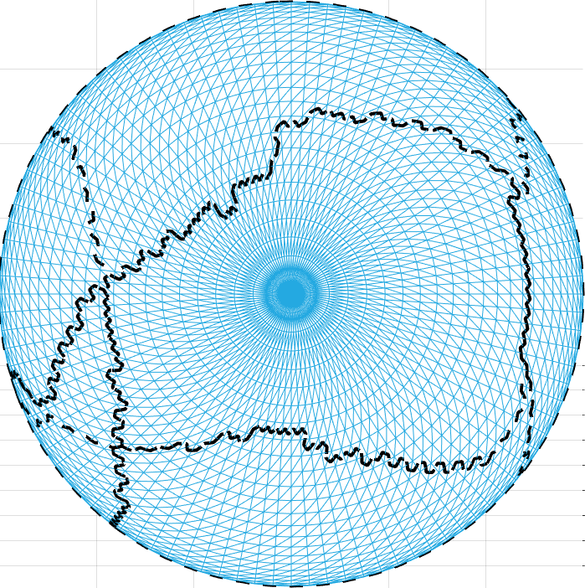
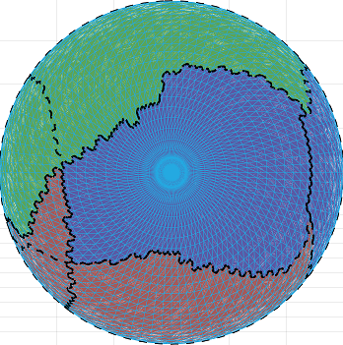
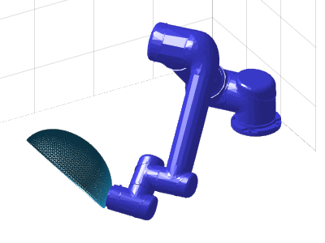
Previous Work Problem Modeling
Giving all-known environment settings
Using colours to represent IK solutions
Modelling into a designing problem of a colour scheme for a graph
Solving the colouring problem
Consider only three classical constraints
Thus overlook the existence of non simply-connected cells
URL: https://arxiv.org/abs/2001.09577v1

Slide 3
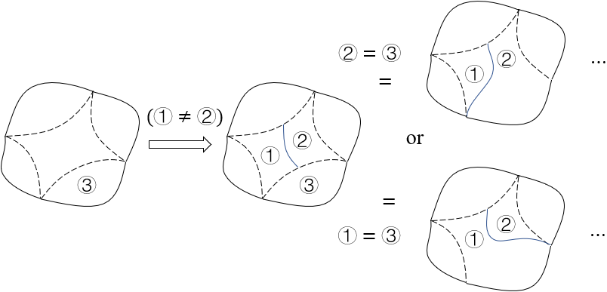
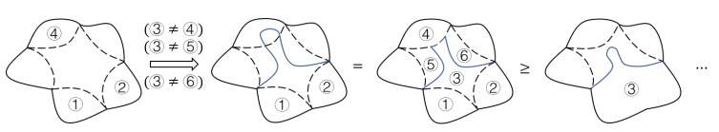
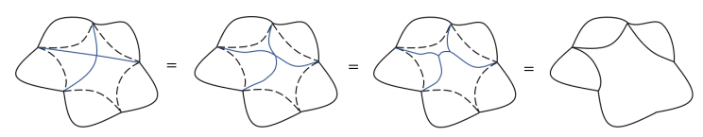
Previous Work Finiteness of Solving Simply-connected Cells
No need to have cutting path starting or ending at middle of edges
No need to have cutting path stretching across edges
No need to have intersecting cutting paths
Only applicable for
simply-connected cell
URL: https://arxiv.org/abs/2001.09577v1

Slide 4
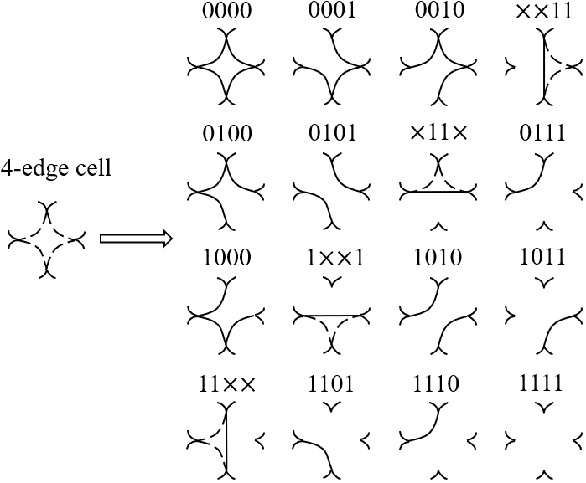
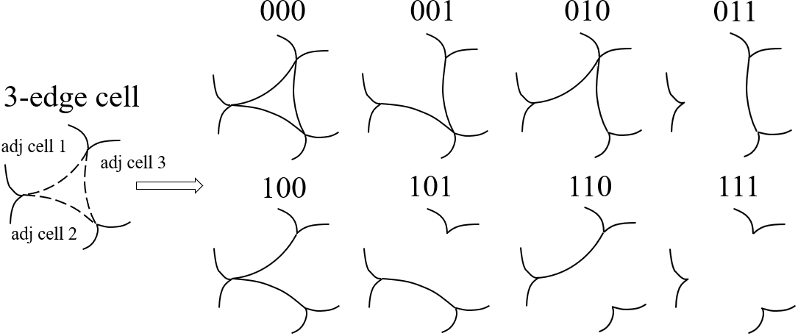
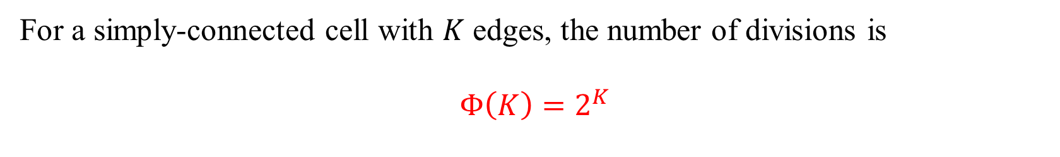
Previous Work Complexity for Simply-connected Cells
For a simply-connected cell with $K$ edges, the number of divisions is
$$Φ\left(K\right)=2^{K}$$
URL: https://arxiv.org/abs/2001.09577v1

Slide 5
Contribution 1: Problem Modeling Necessary Constraints of the Environment Settings
The original problem can be modelled into topological graph as long as:
The singular configurations and their neighbours are abandoned
The constraints are defined in the joint-space and the thresholds are described by strict inequalities.
(see the proof in the paper)

Slide 6
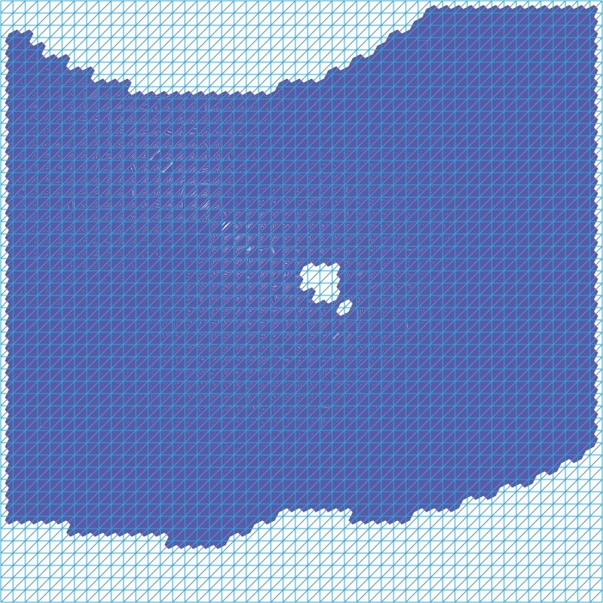
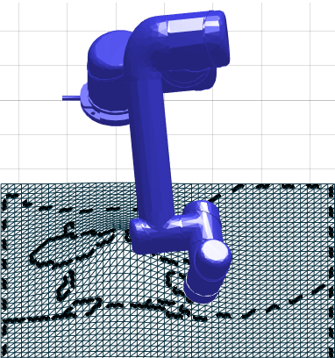
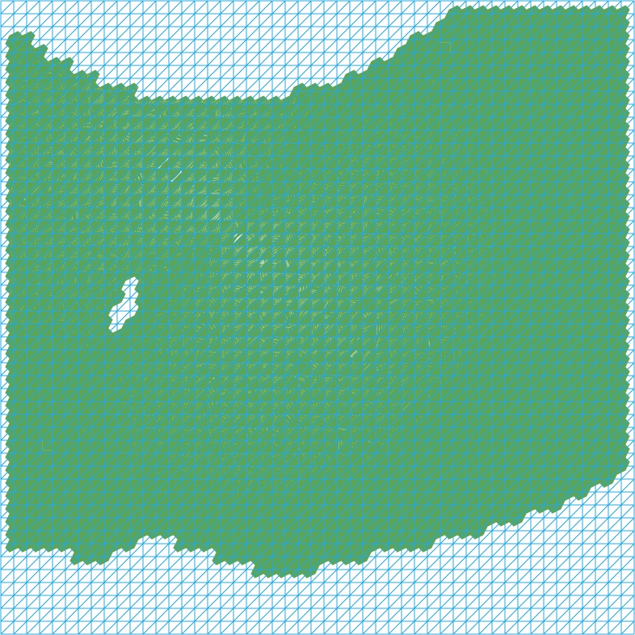
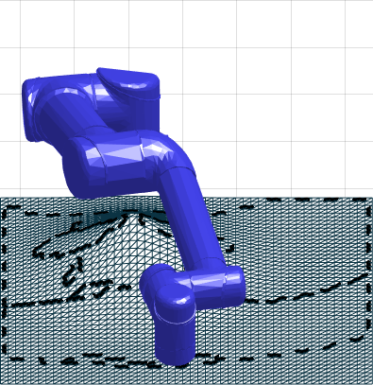
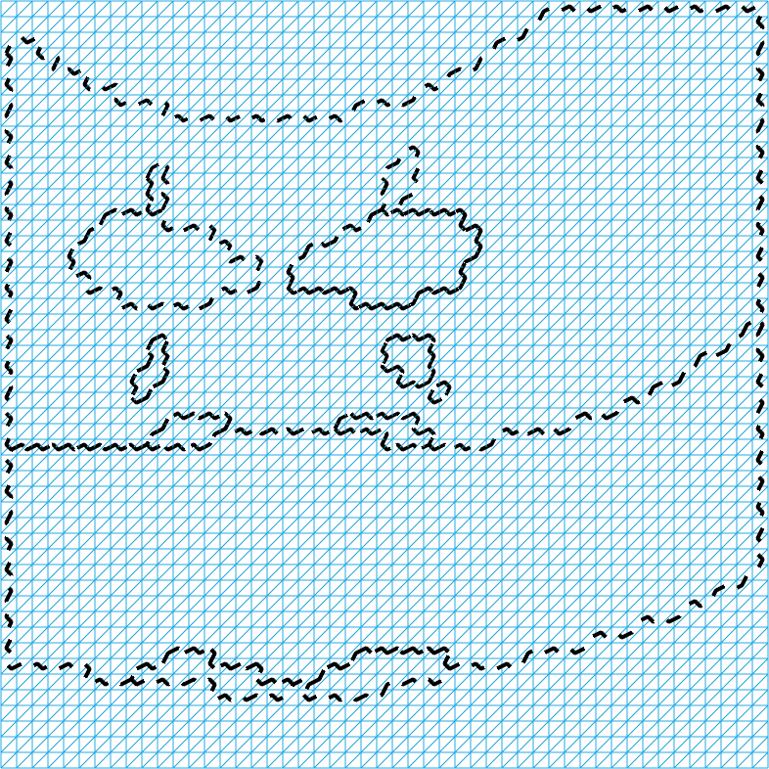
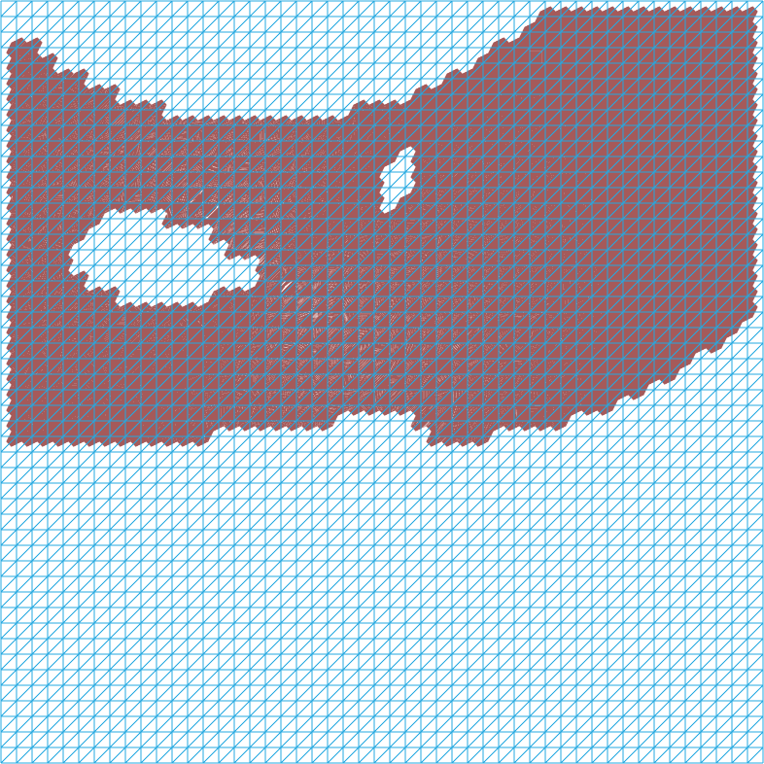
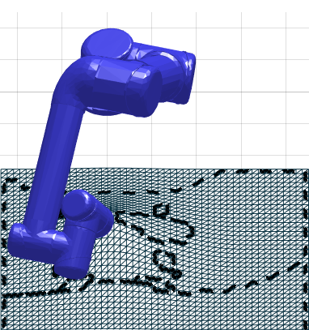
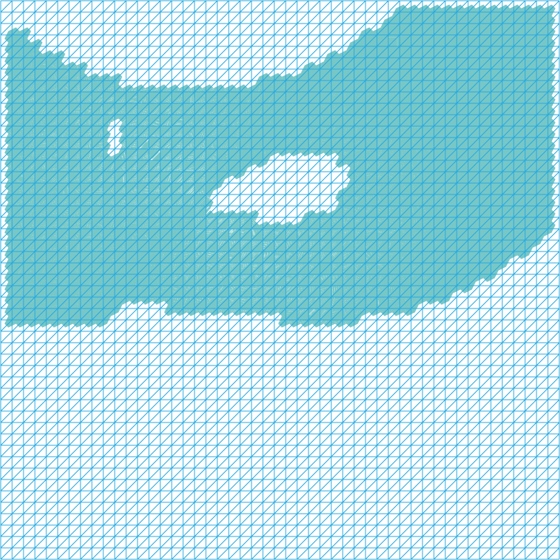
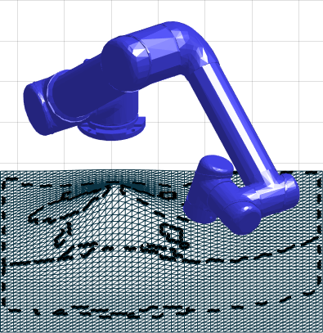
Contribution 1: Problem Modeling(Haven’t finished this page) Examples of non Simply-connected Cells
Notes:
图排好
图上带箭头，展示一下哪里要撞了

Slide 7
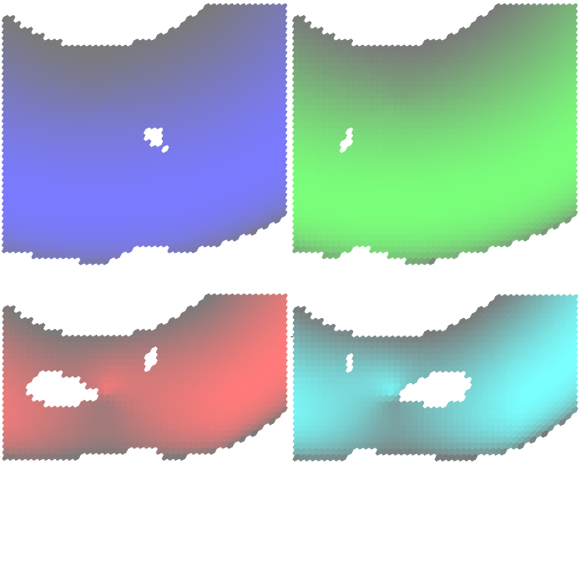
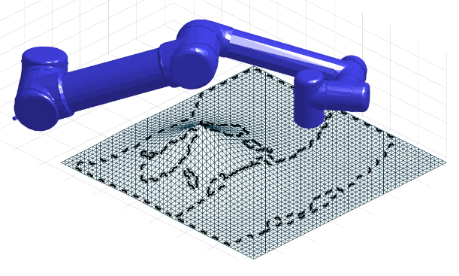
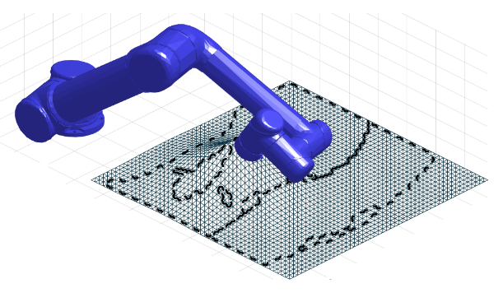
Contribution 1: Problem Modeling (Haven’t finished this page) Examples of non Binary Value Quality Measurements
Manipulability of configurations
High maneuverability
Low maneuverability
If nonlinear thresholds are applied, more complicated topological graph appears.
Notes:
图要换

Slide 8
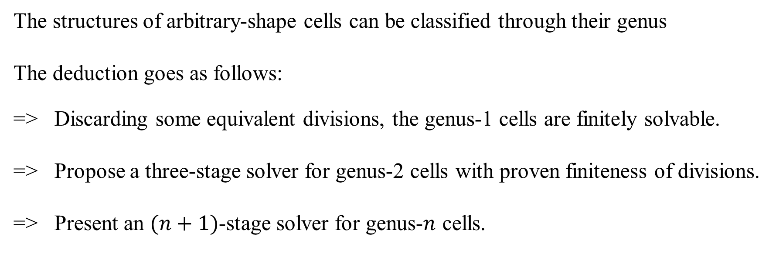
Contribution 2: A Systematic Solution of Topological Graphs
The structures of arbitrary-shape cells can be classified through their genus
The deduction goes as follows:
=> Discarding some equivalent divisions, the genus-1 cells are finitely solvable.
=> Propose a three-stage solver for genus-2 cells with proven finiteness of divisions.
=> Present an $(n+1)$-stage solver for genus-$n$ cells.

Slide 9
Contribution 2: A Systematic Solution of Topological Graphs Solution of Genus-one Cells
Equivalence 1: The disconnected inner part is negligible.
All different divisions (having same cost)
Enforce connecting
cell 1 and cell 2
=
=
=
①
=
=
②
Unconnectable
area
=
①
+
②
Solve the graph without inner cell
Place the inner cell arbitrarily afterwards

Slide 10
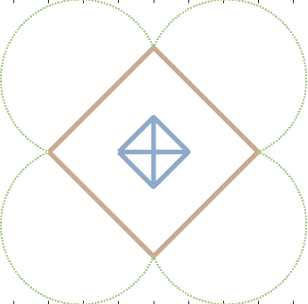
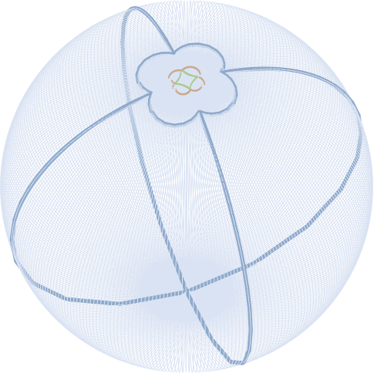
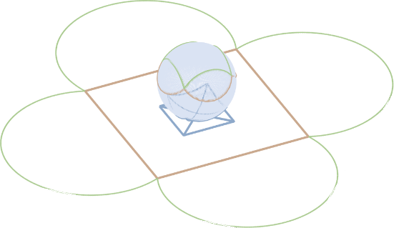
Contribution 2: A Systematic Solution of Topological Graphs Solution of Genus-one Cells
Equivalence 2: The outer part is also negligible
Projecting the original graph
onto the sphere using stereographic projection
A graph with a genus-one cell
(the area between two squares)
The inner part and the outer part interchange their roles.
Summarizing equivalence 1&2:
When the inner part is disconnected, the inner part and the outer part are independent.

Slide 11
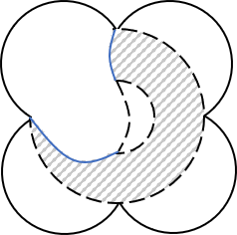
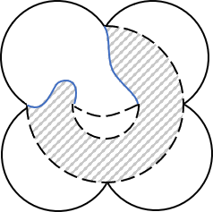
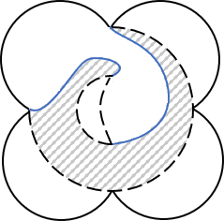
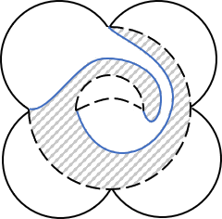
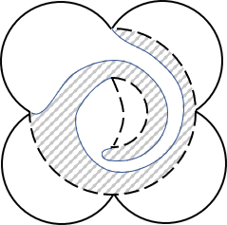
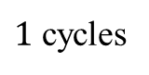
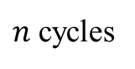
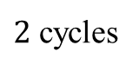
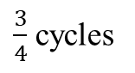
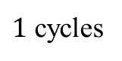
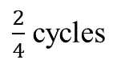
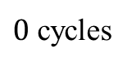
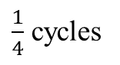

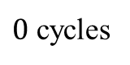
Contribution 2: A Systematic Solution of Topological Graphs Solution of Genus-one Cells
Equivalence 3: The negligibility of cyclic cutting paths
$0$ cycles
$1$ cycles
$2$ cycles
$n$ cycles
=
=
$$⋯$$
a continuous transformation shows the equivalence
=
=
=
=
=
=
$0$ cycles
$\frac{1}{4}$ cycles
$\frac{2}{4}$ cycles
$\frac{3}{4}$ cycles
$1$ cycles
Only the acyclic situations requires explicit consideration.
Once an acyclic solution is optimal, all equivalent cyclic solutions are all optimal.

Slide 12
Contribution 2: A Systematic Solution of Topological Graphs Solution of Genus-one Cells
Equivalence 4: The negligibility of single cutting path
Connecting two inner cells
Connecting two outer cells
Contradiction
two sides of a cutting path must have different colors
(but they are the same cell)
It is not the cutting paths but a connected area that transforms the genus-one cell into simply-connected sub-cells.

Slide 13
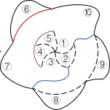
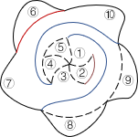
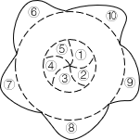
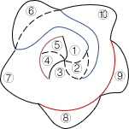
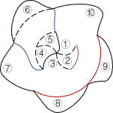
Contribution 2: A Systematic Solution of Topological Graphs Counter Example
The connected edges does not uniquely judge the structure of the cutting paths
Different structures of the cutting paths
Enforce connecting cell 1, 3, 7, 10

Slide 14
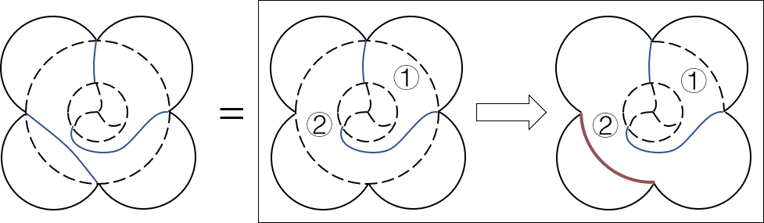
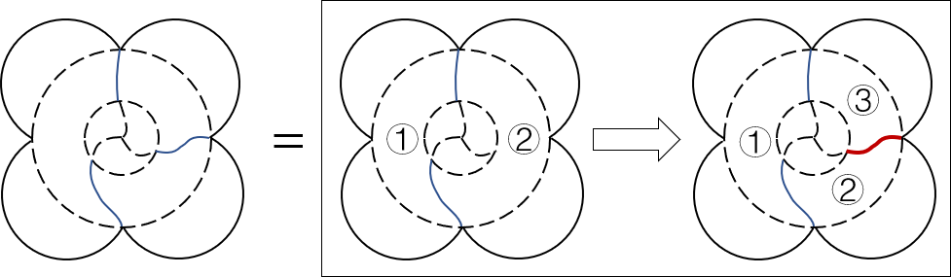
Contribution 2: A Systematic Solution of Topological Graphs 2-Stage Process: Solution of Genus-one Cells
Equivalence 5: The negligibility of cyclic cutting paths
Consider a two-stage process:
Stage 1: The genus-one cell is divided into simply-connected sub-cells
Stage 2: Create further sub-divisions
The cutting paths that start and end at the same boundary (the red one) can be created in stage 2
The third (and later) cutting paths that connect inner boundary and outer boundary can created in stage 2
Hence, in stage 1, all required cutting paths are:
two cutting paths connecting the inner part and the outer part

Slide 15
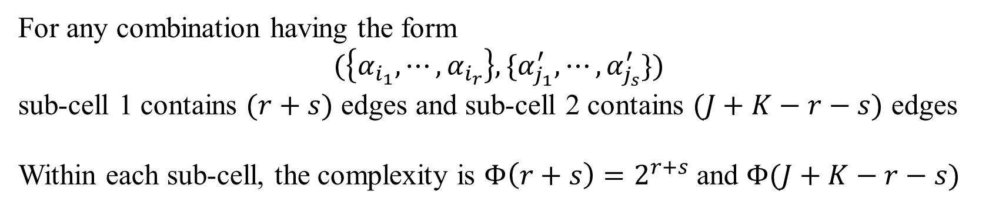
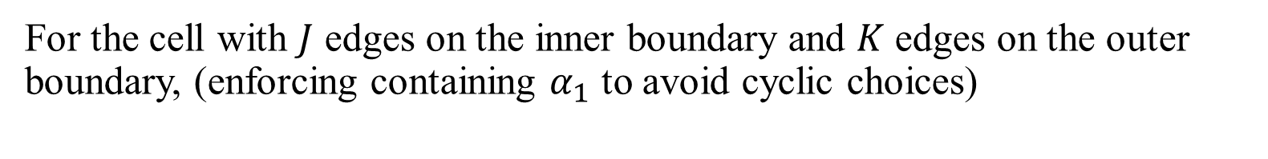
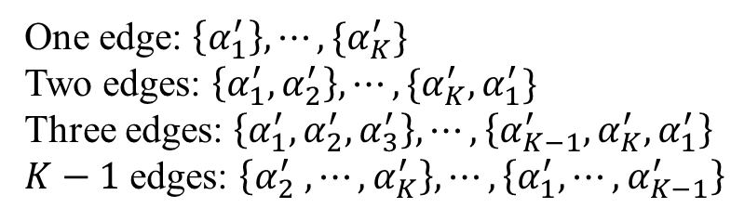



Contribution 2: A Systematic Solution of Topological Graphs Complexity of Solving Genus-one Cells
For the cell with $J$ edges on the inner boundary and $K$ edges on the outer boundary, (enforcing containing $α_{1}$ to avoid cyclic choices)
$r$ methods to choose $r$ edges containing $α_{1}$
$K$ methods to choose $s$ edges
One edge: $\left\{α_{1}\right\}$
Two edges: $\left\{α_{1}, α_{2}\right\}, \{α_{J}, α_{1}\}$
Three edges: $\left\{α_{1}, α_{2}, α_{3}\right\}, \left\{α_{J}, α_{1},α_{2}\right\}, \{α_{J−1}, α_{J}, α_{1}\}$
$J−1$ edges: $\left\{α_{3},⋯, α_{J}, α_{1}\right\}, ⋯, \{α_{1}, ⋯, α_{J−1}\}$
One edge: $\left\{α_{1}^{′}\right\}, ⋯, \{α_{K}^{′}\}$
Two edges: $\left\{α_{1}^{′}, α_{2}^{′}\right\}, ⋯, \{α_{K}^{′},α_{1}^{′}\}$
Three edges: $\left\{α_{1}^{′},α_{2}^{′}, α_{3}^{′}\right\}, ⋯, \left\{α_{K−1}^{′}, α_{K}^{′}, α_{1}^{′}\right\}$
$K−1$ edges: $\left\{α_{2}^{′} , ⋯, α_{K}^{′}\right\}, ⋯, \left\{α_{1}^{′},⋯, α_{K−1}^{′}\right\}$
For any combination having the form
$$(\left\{α_{i_{1}},⋯, α_{i_{r}}\right\}, \{α_{j_{1}}^{′}, ⋯, α_{j_{s}}^{′}\})$$
sub-cell 1 contains $(r+s)$ edges and sub-cell 2 contains $(J+K−r−s)$ edges
Within each sub-cell, the complexity is $Φ\left(r+s\right)=2^{r+s}$ and $Φ(J+K−r−s)$

Slide 16


Contribution 2: A Systematic Solution of Topological Graphs Complexity of Solving Genus-one Cells
If the inner part and the outer part are disconnected,
$$Φ_{0}\left(J,K\right)=Φ\left(J\right)+Φ\left(K\right)=2^{J}+2^{K}$$
If the inner part and the outer part are connected,
$$Ψ\left(J, K\right)=\sum_{r=1}^{J−1}{\sum_{s=1}^{K−1}{rKΦ(r+s)Φ(J+K−r−s)}}$$
Total number of divisions is
$$Φ\left(J,K\right)=Φ_{0}\left(J,K\right)+Ψ\left(J, K\right)$$

Slide 17

Contribution 2: A Systematic Solution of Topological Graphs 3-Stage Process: Solution of Genus-two Cells
For a genus-two cell with its outer boundary defined as
$$ω=\left(α_{1},⋯, α_{K}\right)$$
and inner boundaries defined as
$$ω^{1}=(α_{1}^{1}, ⋯, α_{J_{1}}^{1})$$
$$ω^{2}=(α_{1}^{2}, ⋯, α_{J_{2}}^{2})$$
Stage 1: Insert $ω^{1}$ and create two cutting paths.
(assume that $r_{1}$ edges are chosen from $ω^{1}$, $s$ edges are chosen from $ω$)
Stage 2: Insert $ω^{2}$ and create two cutting paths.
Stage 3: Creating all sub-division cutting paths.

Slide 18









Contribution 2: A Systematic Solution of Topological Graphs 3-Stage Process: Solution of Genus-two Cells
Equivalence 6: Negligibility of putting inner part on the cutting paths
$ω^{2}$ is not on cutting paths
$①$ and ② are connectable
stage 1 has finished
$ω^{2}$ is on cutting paths
non-optimal
($①$ and ② are unconnectable)
Hence, in stage 2, only two conditions need consideration:
In sub-cell 1→ a new genus-one cell with ${(r}_{1}+s)$ outer edges and $J_{2}$ inner edges
In sub-cell 2→ a new genus-one cell with $\left(J_{1}+K−r_{1}−s\right)$ outer edges and $J_{2}$ inner edges

Slide 19

Contribution 2: A Systematic Solution of Topological Graphs Complexity of Solving Genus-two Cells
When $ω^{1}$ and $ω^{2}$are both disconnected,
$$Φ_{00}\left(J_{1},J_{2},K\right)=2^{J_{1}}+{2^{J_{2}}+2}^{K}$$
If $ω$ and $ω^{1}$ are connected, but $ω^{2}$ is disconnected,
$$Φ_{10}\left(J_{1},J_{2},K\right)=Ψ\left(J_{1}, K\right)+Φ\left(J_{2}\right)$$
Exchanging the role of $ω^{1}$ and $ω^{2}$,
$$Φ_{01}\left(J_{1},J_{2},K\right)=Ψ\left(J_{2}, K\right)+Φ\left(J_{1}\right)$$
When both $ω^{1}$ and $ω^{2}$ are connected, we use $Ξ_{1}$ for the situation that $ω^{2}$ is placed in sub-cell 1, and $Ξ_{0}$ for sub-cell 2, then
$$Ξ_{1}\left(J_{2};r_{1},J_{1},s,K\right)=Ψ\left(J_{2},r_{1}+s\right)Φ\left(J_{1}+K−r_{1}−s\right)$$
$$Ξ_{0}\left(J_{2};r_{1},J_{1},s,K\right)=Φ\left(r_{1}+s\right)Ψ\left(J_{2},J_{1}+K−r_{1}−s\right)$$
Summarizing $r_{1}$ and s, we have
$$Ψ\left(J_{1},J_{2},K\right)=\sum_{r_{1}=1}^{J_{1}−1}{\sum_{s=1}^{K−1}{r_{1}K[Ξ_{1}\left(J_{2};r_{1},J_{1},s,K\right)+Ξ_{0}\left(J_{2};r_{1},J_{1},s,K\right)]}}$$
Summarizing the formulas above, total number of divisions is
$$Φ\left(J_{1},J_{2},K\right)=Φ_{00}\left(J_{1},J_{2},K\right)+Φ_{01}\left(J_{1},J_{2},K\right)+Φ_{10}\left(J_{1},J_{2},K\right)+Ψ\left(J_{1},J_{2},K\right)$$

Slide 20


Contribution 2: A Systematic Solution of Topological Graphs $(n+1)$-Stage Process: Solution of Genus-$n$ Cells
For a genus-$n$ cell with its outer boundaries defined as
$$ω=\left(α_{1},⋯, α_{K}\right)$$
and inner boundaries defined as
$$ω^{i}=\left(α_{1}^{i}, ⋯, α_{J_{i}}^{i}\right), ∀i=1, ⋯, n$$
Stage 1: Insert $ω^{1}$ and create two cutting paths.
Stage $i(=2, ⋯, n)$: Insert $ω^{2}$ to one of the sub-cells after stage $(i−1)$
and create two cutting paths.
Stage $(n+1)$: Create all sub-division cutting paths.

Slide 21









Contribution 2: A Systematic Solution of Topological Graphs An Example of the $(n+1)$-Stage Process
Init graph
Stage 1
Stage 2
Stage 3
$$⋯$$

Slide 22


Contribution 2: A Systematic Solution of Topological Graphs Complexity of Solving Genus-$n$ Cells
Let the subscript $T_{n}$ be a binary string with length $n$. The digit sum of $T_{n}$ is $N\left(T_{n}\right)$.
When $N\left(T_{n}\right)=0$, i.e., no inner boundary is connected,
$$Φ_{0⋯0}\left(J_{1}, ⋯,J_{n},K\right)=2^{J_{1}}+⋯+ {2^{J_{n}}+2}^{K}$$
If $N\left(T_{n}\right)=1$, for example, $ω^{1}$ and $ω$ are connected
$$Φ_{10⋯0}\left(J_{1},⋯,J_{n},K\right)=Ψ\left(J_{1}, K\right)+2^{J_{2}}+⋯+2^{J_{n}}$$
(other ${(C}_{n}^{1}−1)$ terms are calculated through exchanging the indices)
An example for $N\left(T_{n}\right)=2$ is
$$Φ_{110⋯0}\left(J_{1},⋯, J_{n},K\right)=Ψ\left({J_{1},J}_{2}, K\right)+2^{J_{3}}+⋯+2^{J_{n}}$$
(other ${(C}_{n}^{2}−1)$ terms are calculated through exchanging the indices)
$N\left(T_{n}\right)=0, 1, ⋯, n−1$ can be easily calculated through previous formulas.

Slide 23

Contribution 2: A Systematic Solution of Topological Graphs Complexity of Solving Genus-$n$ Cells
For $N\left(T_{n}\right)=n$, we first finish stage 1. Then, we can choose which sub-cell that each $ω^{i}, i=2, ⋯, n$ will finally lie in. $Ξ_{T_{n−1}}$ are used to consider all situations, where the $i$-th digit of $T_{n−1}$ is 0 or 1 represents that $ω^{i}$ lies in sub-cell 1 or sub-cell 2.
Let $B(T, i)$ be the value of the $i$-th digit of $T$,
$$B\left(T, i\right)=\frac{T}{2^{n−1}} mod 2$$
then
$$Ξ_{T_{n−1 }}\left(J_{2}, ⋯, J_{n};r_{1},J_{1},s,K\right)=Ψ\left(J_{i_{2}}, ⋯, J_{i_{p}},r_{1}+s\right)Ψ\left(J_{i_{P+1}}, ⋯, J_{i_{n}}, J_{1}+K−r_{1}−s\right)$$
where
$$\left\{\begin{aligned}B\left(T_{n−1}, i_{j}\right)=1, j=2, ⋯, P \\ B\left(T_{n−1}, i_{j}\right)=0, j=P+1, ⋯, n\end{aligned}\right.$$

Slide 24

Contribution 2: A Systematic Solution of Topological Graphs Complexity of Solving Genus-$n$ Cells
Summarizing all possible $r_{1}$ and s in stage 1, we have
$$Ψ\left(J_{1},{⋯, J}_{n},K\right)=\sum_{r_{1}=1}^{J_{1}−1}{\sum_{s=1}^{K−1}{r_{1}K\left(\sum_{T_{n−1}=0}^{2^{n−1}−1}{Ξ_{T_{n−1}}\left(J_{2},⋯, J_{n};r_{1},J, s, K\right)}\right)}}$$
Summarizing the formulas above, total number of divisions is
$$Φ\left(J_{1},⋯,J_{n},K\right)=\sum_{T_{n}=0}^{2^{n}−2}{Φ_{T_{n}}\left(J_{1},⋯, J_{n}, K\right)}+Ψ(J_{1},⋯, J_{n}, K)$$

Slide 25






Experiment : Polishing a wok without an obstacle
Find All Configurations
Define Colors
Create Topological Graph
One of the Optimal Solutions
The least number of discontinuities is 1.
(The physical cutting path is arbitrary.)
Some other configurations
Omitted
Notes:
实验，我会把视频做出来

Slide 26
Thanks for watching
Tong Yang, Jaime Valls Miro, Yue Wang, Rong Xiong
Robotic Laboratory, Zhejiang University
Centre for Autonomous Systems (CAS), University of Technology Sydney

